Slide 1
Logistic Regression

Slide 2

Delta Analytics builds technical capacity around the world.
This course content is being actively developed by Delta Analytics, a 501(c)3 Bay Area nonprofit that aims to empower communities to leverage their data for good.
Please reach out with any questions or feedback to inquiry@deltanalytics.org.
Find out more about our mission here.

Slide 3
Quick Review

Slide 4

Regression & Classification
ML studies how to automatically learn to make accurate predictions based on past observations.
Two types of supervised tasks, regression and classification.
Regression
Continuous variable
Ordinary Least Squares (OLS) regression
Classification
Categorical variable
Logistic regression

Slide 5
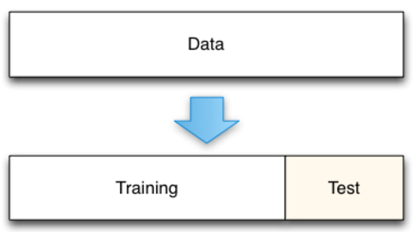
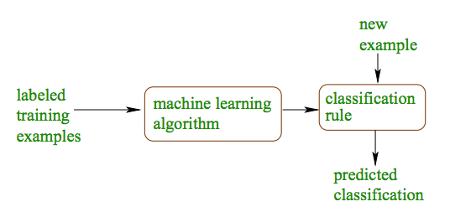
Model’s Performance and Evaluation
Ability to generalize to unseen data:
Predicted Y - Actual Y
Source: Machine Learning Algorithms for Classification, Schapire (2016)
General Steps:
Split data into “training” and “test” sets.
Use regression/classification results from “training” set to predict“test” set
Compare “Predicted Y” to “Actual Y”
Validation metrics (OLS):
** R^2 ** Adjusted R2 ** MSE
Notes:
R^2 := R-Squared Statistical Measure
Adjusted R^2 := Corrective R^2 Statistical Measure
MSE := Mean Squared Error

Slide 6
Module 3: Logistic Regression

Slide 7
Overview of Logistic Regression:
Task
Model the probability that Y belongs to a particular category
Learning Experience
Supervised
Performance Measure
Accuracy, Misclassification Rate, Precision, Recall. ROC Curve, Confusion Matrix, etc.
Source: Deep Learning Book - Chapter 5: Introduction to Machine Learning

Slide 8
Task

Slide 9
Module Checklist
Logistic Regression
Task
Dilemma using OLS
Odds ratio
Logit link function
Probability thresholds
Learning Experience
Cost function
Optimization process
Performance
Confusion Matrix
ROC and AUC

Slide 10

Task
Dilemma using OLS
A linear regression with variable(s) matrix X predicting target y is formulated as:
SUM ( predictors j thru p (columns) of the matrix X )
Beta (j), coefficient for the predictor x_{j} , the j ^{th} column in variable matrix X
Expected value (mean) of y given variable matrix X
Beta (zero) intercept
With linear regression, it is difficult to assign some observation value x to some category value y.
Example:
Predict college admissions using GRE, GPA, and college prestige
What would our output category value “College Admissions” be?
Notes:
When we say “Category Value”, we mean non-numerical value (real integer or category)
(e.g. 1,2,3 or “Cat”, “Dog”, “Dog”)
Note: We do not use the x_i or y_i notation, but rather use term “some” value.

Slide 11



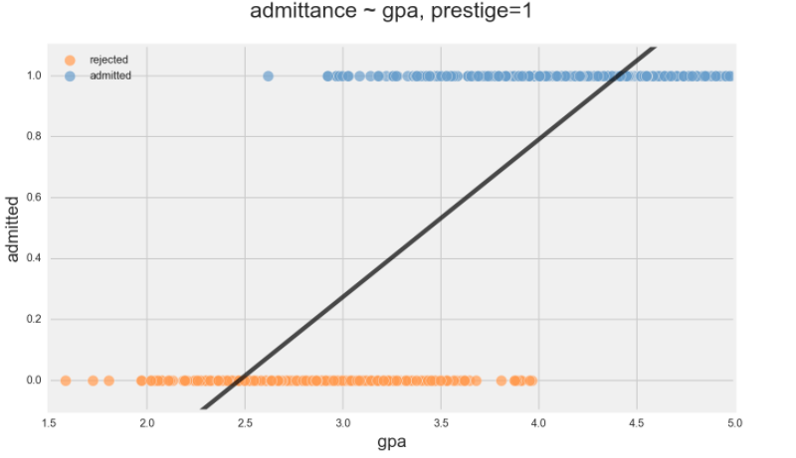

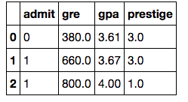

Task
Dilemma using OLS
Predicting College admission from gpa, gre and school prestige
Houston we have a problema!!
Notes:
College Admission is target (column) “admit”

Slide 12


Task
Dilemma using OLS
Framing the idea in classification terms
We have a basic “binary” classification problem
1 = admitted and 0 = rejected
Keep in mind that the logistic regression is still solving for an expected value. In the binary classification case this expected value is the probability of one class:
In regression syntax we would have:
Questions?

Slide 13


Task
Dilemma using OLS
Estimate the probability instead of a real number!!!
There is a problem with this new equation: we want to estimate a probability instead of a real number.
We need y to fall in the range [-infinity, infinity] for the regression to be valid!
Here is where the logit “link function” comes to our rescue!!
y to fall in the range [ -infinity, infinity ]

Slide 14



Task
Odds ratio
Probability of class membership….
Logistic regression is a twist on regression for categorical/class target variables, where instead of solving for the mean of y, logistic regression solves for the probability of class membership of y.
How does it do this? It uses a link function to describe a linear relationship between the probability and our independent variables
The link function is a function of the expected value of the target variable
Notes:
Let’s all do the Twist
Logit Function

Slide 15

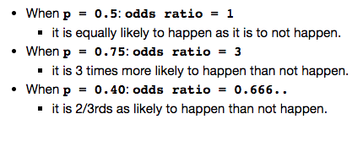

Task
Odds ratio
Modify regression equation…
What is our link function in the case of logistic regression?
Our link function will use something called the odds ratio
The odds ratio of a probability p is a measure of how many times more likely it is than the inverse case.
Questions?
Notes:
Example Calculation
For p=0.40, odds ratio(.40)
= odds ratio(4/10) = (4/10) / (1- (4/10)) = (4/10) / (10/10-4/10)
= (4/10) / (6/10) = 4/6 = ⅔ = .66...

Slide 16
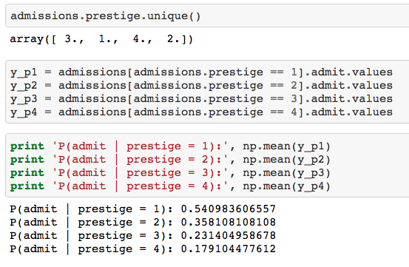
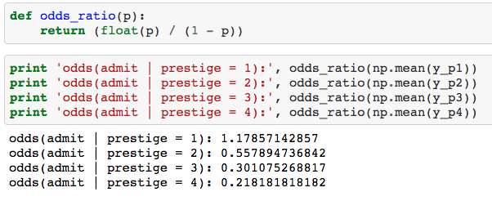
Task
Odds ratio
In our example...
Predicting college admission
Probabilities of admittance by college prestige
Odds ratios of admittance by college prestige

Slide 17

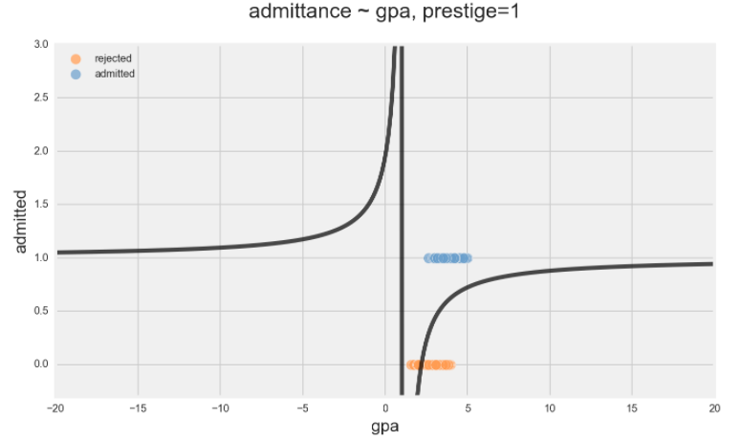

Task
Odds ratio
Modify regression equation…
If we put the odds ratio in place of the probability in the regression equation, the range of odds ratio, our predicted value, is now restricted to be in the range [0, infinity]
And graphically will look like this:
….. hmm something is missing ….

Slide 18
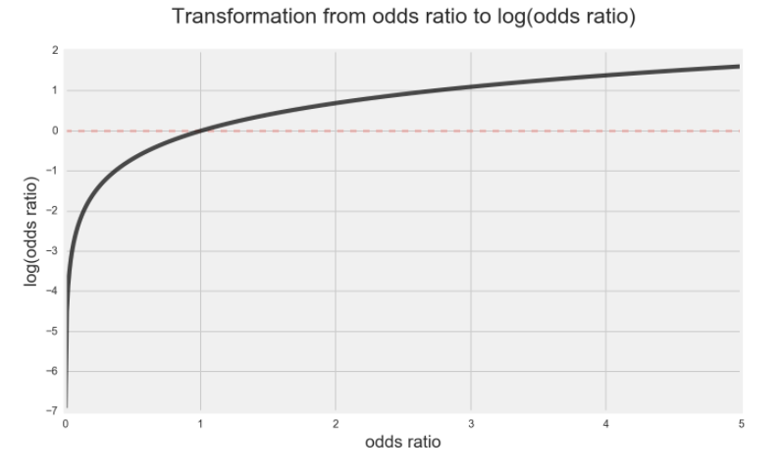

Task
Logit link function
Modify regression equation…
If we take the natural logarithm of a variable that falls between 0 and infinity, we can actually transform it into a variable that falls between the range negative infinity and infinity.
Why? Because taking the logarithm of fractions results in negative numbers.
And now our graph looks like:
… this is how it needs to look..
Notes:
Logarithm of fractions examples Video

Slide 19

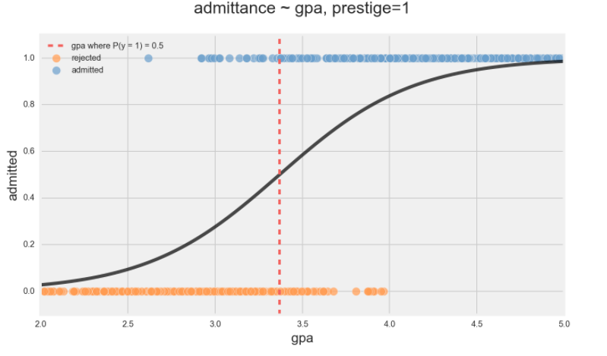
Task
Logit link function
Modify regression equation…
The combination of converting the probability to an odds ratio and taking the logarithm of that is called the logit link function, and is what regression uses to estimate probability:
Graphically looks like this:
Houston we solved the problema!

Slide 20
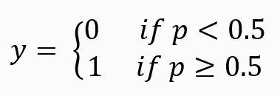
Task
Probability thresholds
Now that we have a probability, how do we actually classify the data?
Choose a probability depending on the type of the classification problem we’re solving for:
In this case, 0.5 is the threshold probability. Threshold can be adjusted by model.

Slide 21

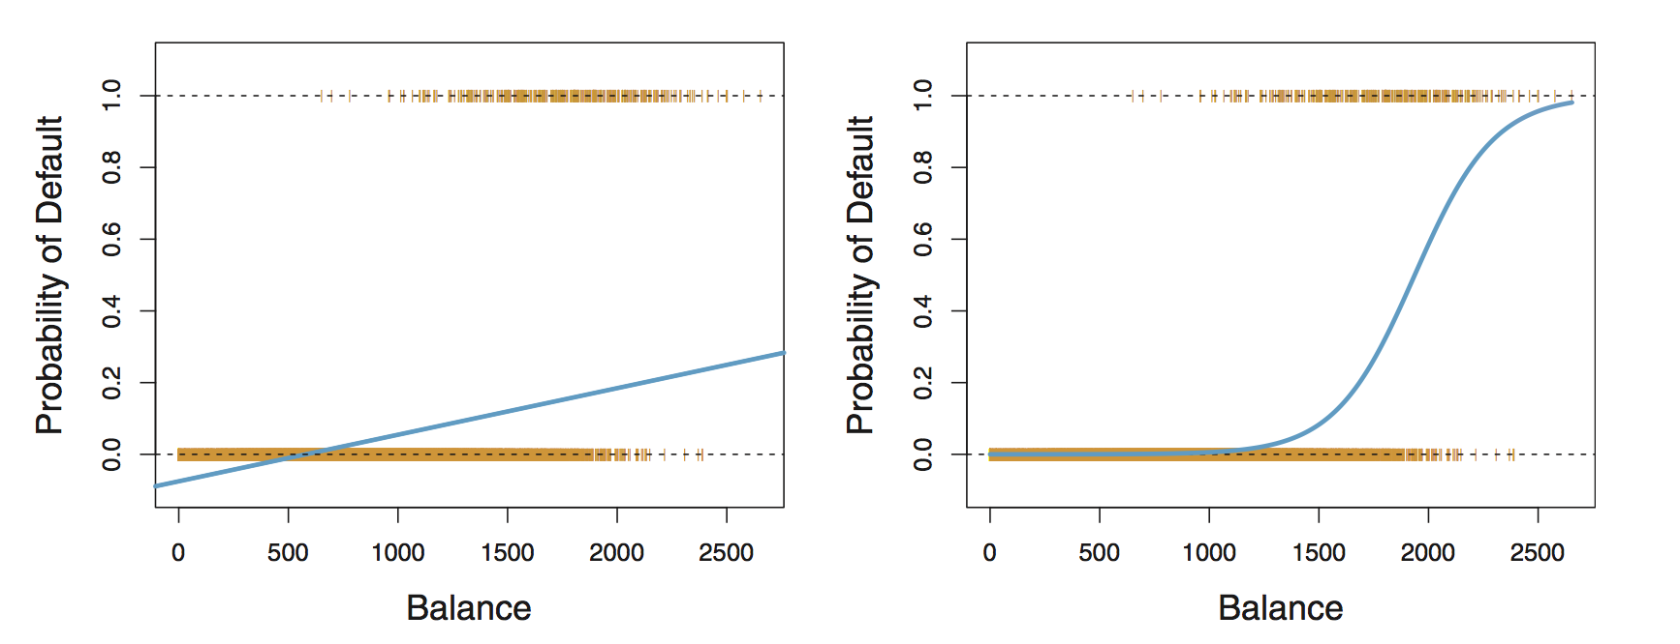
Task
Let’s check our understanding of logistic regression
Here is a classification example, where account balance is used to predict the probability of default.
Can you guess what is the correct classification method linear regression (left) and logistic regression (right)?
Questions?
Notes:
Source: An Introduction to Statistical Learning

Slide 22
Learning Methodology

Slide 23
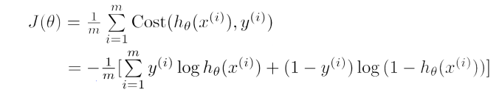
Learning Experience
Cost function
Logistic regression, like OLS, is solved by minimizing a loss function, also called a cost function
The cost function for OLS was the RSS (residual sum of squares), but the cost function for logistic regression is:

Slide 24
Learning Experience
Cost function
Let’s break this down. We want to minimize the cost function, J
1. For each classifier we’ve predicted...
2. Add up the “cost” of the prediction, where h(x) is the prediction and y is the actual classification

Slide 25
Learning Experience
Cost function
The cost function should be higher when our predictions are wrong and lower when they are right
The cost function meets our need! When h(x) = 1 and y(0) , then the cost function is infinite

Slide 26
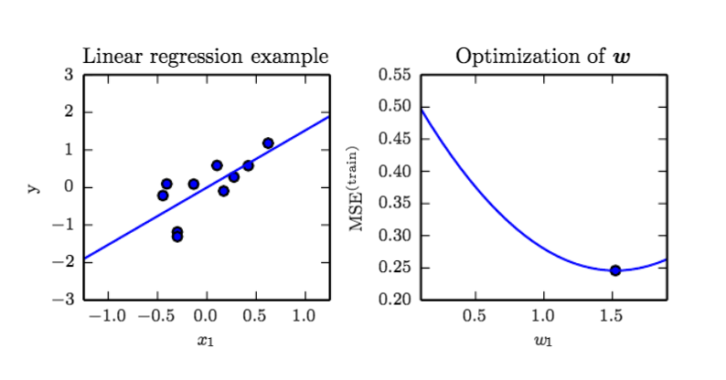
Learning Methodology
Optimization process
Optimization of MSE:
Like OLS, logistic regression learns by gradient descent to minimize the cost function
Reminder of gradient descent from OLS
Questions?
Source: Seeing Theory - Regression

Slide 27
Performance Metrics

Slide 28

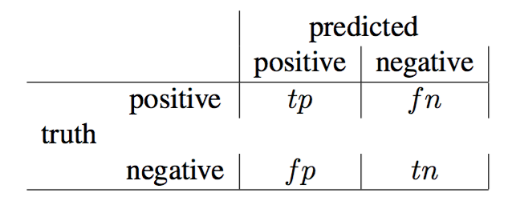
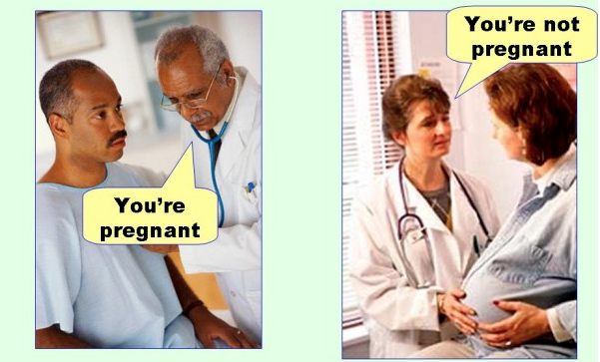
Performance
Model evaluation
Confusion Matrix
Imagine you are going to see your doctor and you get an incorrect diagnosis
True Positive ( tp ): The cases in which the model predicted "yes/positive", and the truth is also “yes/positive."
True Negatives ( tn ): The cases in which the model predicted "no/negative", and the truth is also "no/negative."
False Positives ( fp ): The cases in which the model predicted "yes/positive", and the truth is "no/negative".
False Negatives ( fn ): The cases in which the model predicted "no/negative", and the truth is "yes/positive".
Source: Computing for the Social Sciences, University of Chicago

Slide 29

Performance
Model evaluation
Using information from the confusion matrix
Number samples:
n = tp + tn + fp + fn
Accuracy:
In general how often is the classifier correct? => ( tp + tn) / n
Misclassification Rate (Error Rate):
How often is the model wrong => (fp + fn) / n
Precision:
When the model predicts "yes", how often is it correct? => tp / (tp + fp)
Recall (True Positive Rate):
How often the model predicts yes, when it's actually yes => tp / ( tp + fn)
This is so confusing

Slide 30
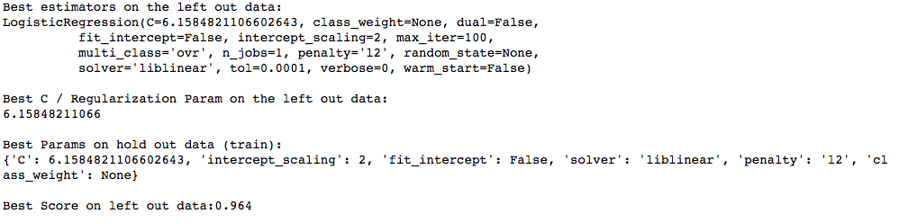
Performance
Model evaluation Example
Can we predict if a congressmen/women is a republican or democrat? Let’s use the 1984 United States Congressional Voting Records Database
Assume that we have set and run a logistic regression (gridsearch for hyperamaters), etc and we got the following output:
Hmm??
Now, evaluate the model => knowing that if we randomly choose from our dataset, 61 % of the time you will guess /choose democrat (there are 267 democrats and 168 republicans in the dataset)
Note: In this lecture, we are omitting other factors (class imbalance, how to gridsearch hyperparameters, etc).

Slide 31

Performance
Model evaluation Example
Here is the confusion matrix, let's calculate some model performance indicators
Number of samples:
n = tp + tn + fp + fn => 49 +78 + 2 + 2 = 131
Accuracy:
In general how often is the classifier correct? => ( tp + tn) / n
=> (49+78) 131 => 0.9694 or 96.94%
Misclassification Rate (Error Rate):
How often is the model wrong => (fp + fn) / n => 4 / 131 => 0.03053 or 3.053%
Precision:
When the model predicts "yes", how often is it correct? => tp / (tp + fp)
=> 49 / (49 + 2) => 97.5%
Recall (True Positive Rate):
How often the model predicts yes, when it's actually yes => tp / ( tp + fn)
=> 49 / (49 + 2) => 97.5%
Now I get it!

Slide 32
Performance
Model evaluation
Wait.. there is more?!
Other thresholds
What if instead of boosting the overall model accuracy, we want to improve a “class-specific” accuracy?
This can be the case when we want to increase sensitivity/recall => increase of the true positive rate (TPR)
True Positive Rate = tp / ( tp + fn ) => 49 / (49 + 2) => 97.5%
On the other hand, if we want to increase specificity we will need to increase the true negative rate (TNR)
False Positive Rate = fp / ( fp + tn) => 2 / (2 + 78) => 2.5%
How do we accomplish this?
Estimate a better model (achieve higher sensitivity and specificity)
Use our existing model to meet one of these goals
Adjusting a threshold, or the cut-off point for classifying individuals as “democrats or republicans”

Slide 33
Performance
Model evaluation
ROC Curve
How do we select a threshold?
We can graph across many combinations of thresholds, and then select a threshold level at a point on which we are comfortable.
The best approach is having domain knowledge on the benefits and costs of making/considering a threshold (trade off).
Receiving Operating Characteristic (ROC) visual way to inspect the performance of a binary classifier
In a nutshell with a ROC curve we're measuring the “trade off” between the rate at which the model correctly predicts something, with the rate at which the model predicts something incorrectly.
As the class assignment threshold increases for the positive class, the false positive rate and true positive rate necessarily increase.

Slide 34
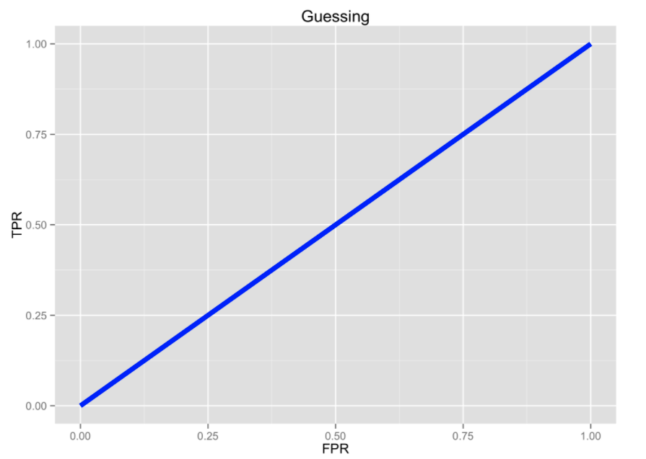
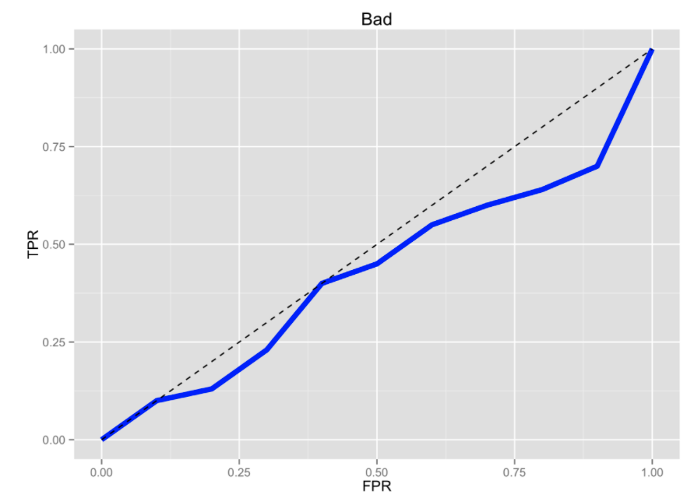
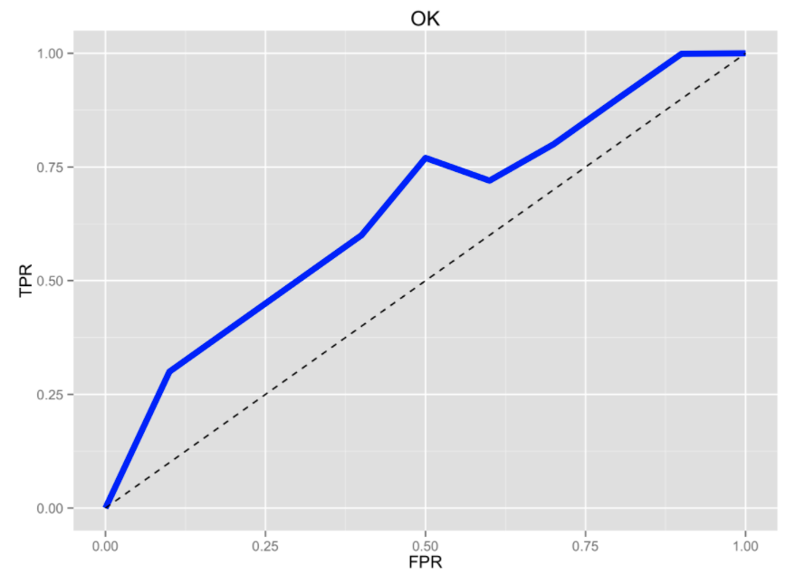
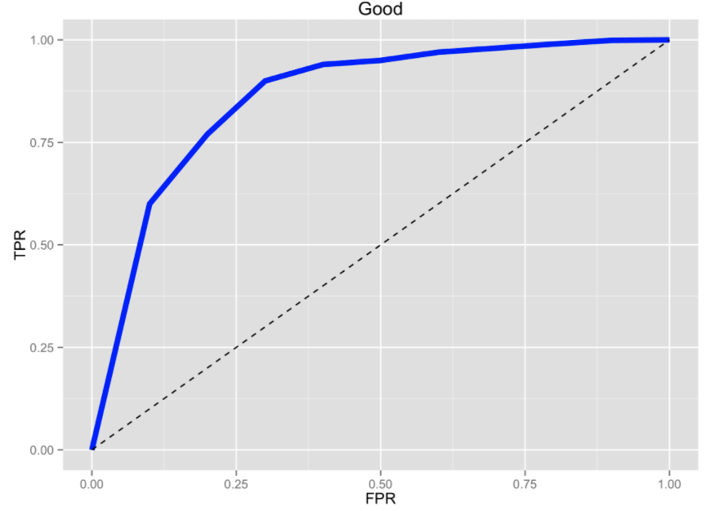
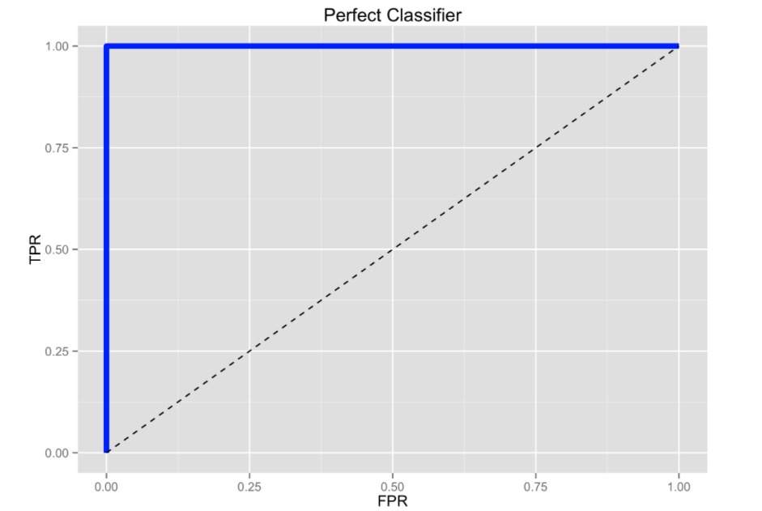
Performance
Model evaluation
Some examples por favor?
ROC Curve
Worse than guessing, the blue line is below the dotted line
Mediocre classifier, lines that show dips
Classifier is making completely random guesses (50/50 chance)
Good Classifier, the ideal scenario where there is a 'hump shaped' curve that is continually increasing
A perfect classifier is the one that shows a perfect trade-off between TPR and FPR => TPR of one and FPR of zero
Source: yhat

Slide 35
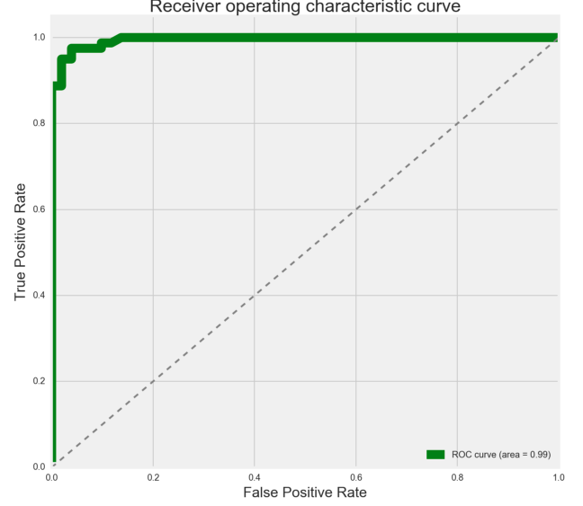
Performance
Model evaluation
ROC and AUC from Republican/Democrat case?
ROC Curve and AUC
There is one more concept we should know:
Area under the curve or AUC, is the amount of space underneath the ROC curve.
AUC shows how well the TPR and FPR is looking in the aggregate.
The greater the area under the curve, shows the higher quality of the model.
The greater the area under the curve, the higher the ratio of true positives to false positives as the threshold becomes more lenient
AUC = 0 => BAD
AUC = 1 => GOOD

Slide 36
Module Checklist
Logistic Regression
Task
Dilemma using OLS
Odds ratio
Logit link function
Probability thresholds
Learning Experience
Cost function
Optimization process
Performance
Confusion Matrix
ROC and AUC

Slide 37
Advanced resources

Slide 38
Want to take this further? Here are some resources we recommend:
Textbooks
An Introduction to Statistical Learning with Applications in R (James, Witten, Hastie and Tibshirani): Chapters 4.1, 4.2 4.3
Online resources
Statistical learning: logistic regression - MACS 30100 - Perspectives on Computational Modeling
Simple guide to confusion matrix terminology
A Simple Logistic Regression Implementation
If you are interested in gridsearch of hyperparameters:
Tuning the hyper-parameters of an estimator
LogisticRegression (sklearn.linear_model)

Slide 39
Congrats! You finished the module!
Find out more about Delta’s machine learning for good mission here.

